Slide 1

Year 10 Information Evening
23rd October 2025

Slide 2
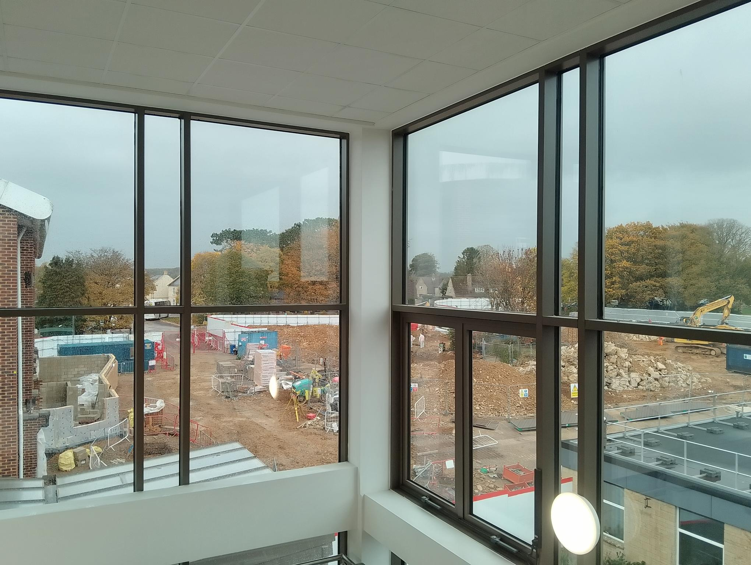

Building
Notes:
Successful demolition phase of existing structures.
No issues with exams and the last 2 years.
Completion scheduled for Easter, pre-exams.
No impact on venues for mocks and finals (as per every other year)

Slide 3


Slide 4
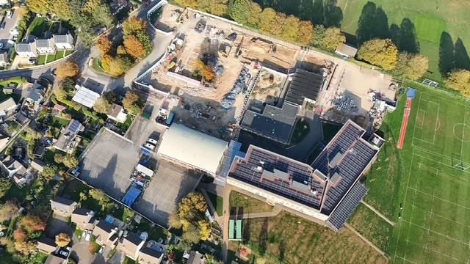

Slide 5
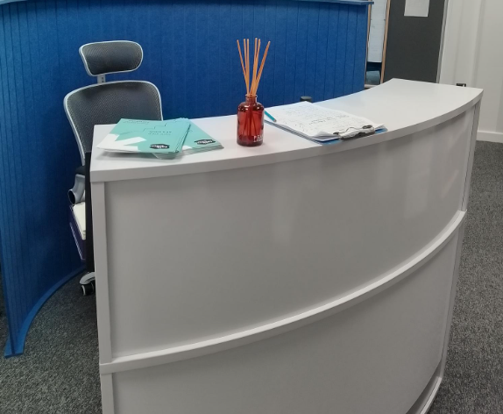
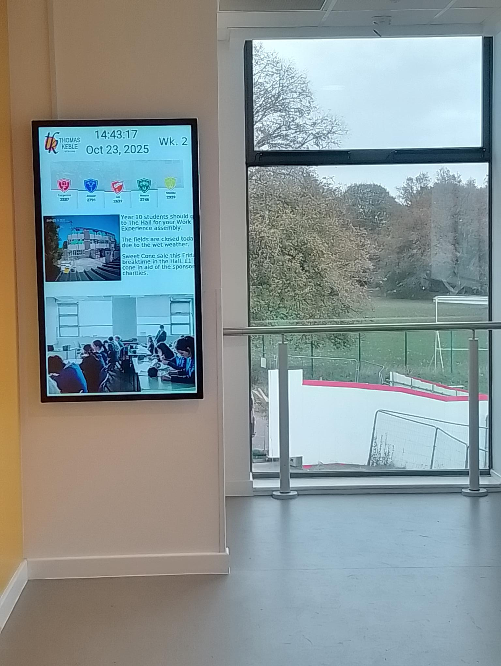

Slide 6
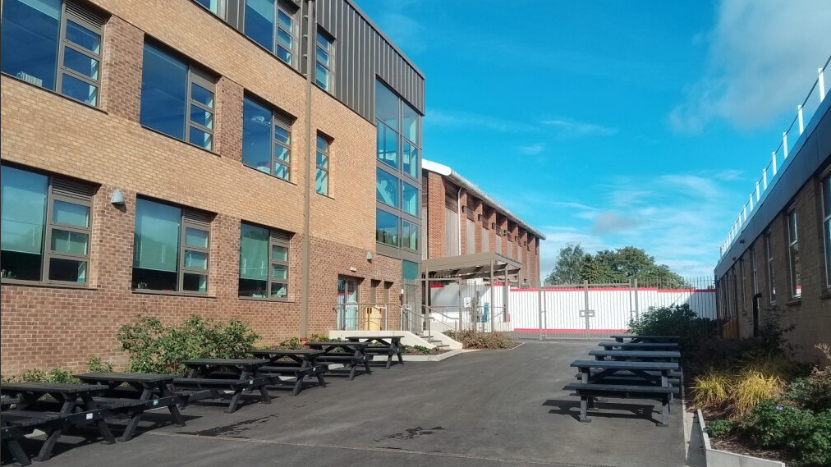

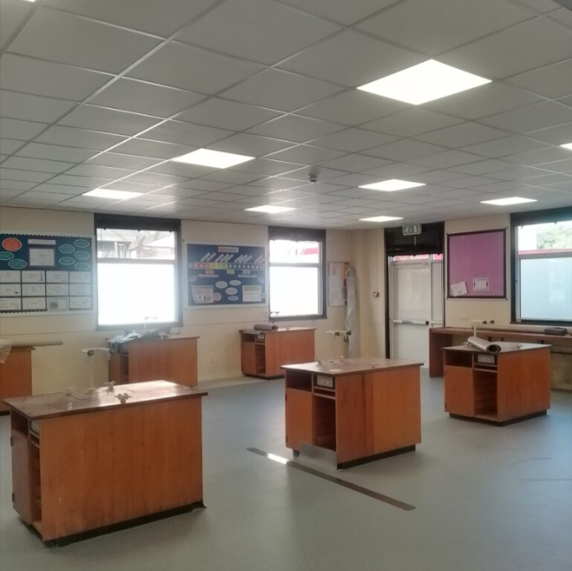
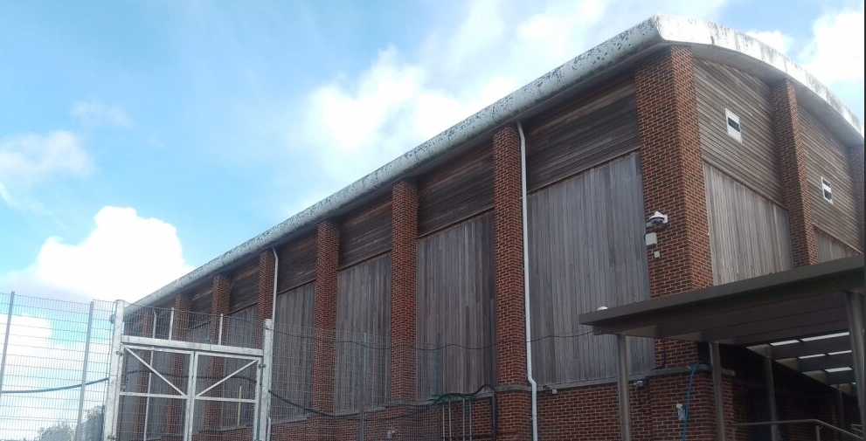
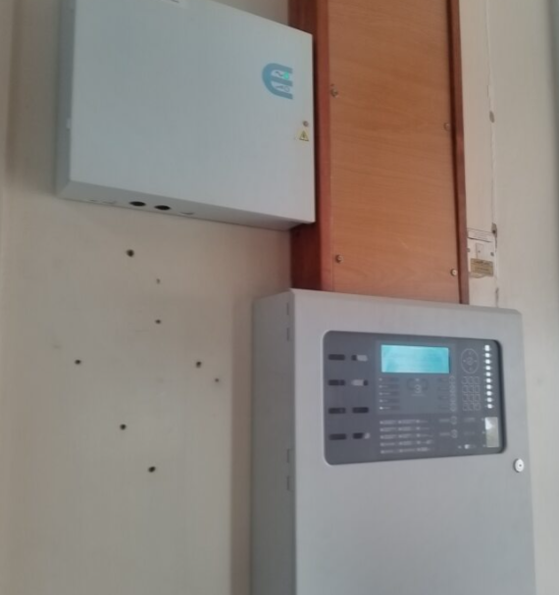

Slide 7
Curriculum

Slide 8
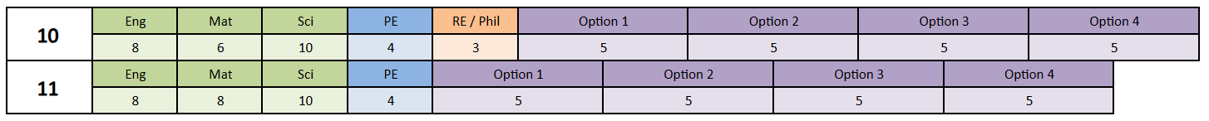
5 English classes - 4 mixed and 1 smaller
5 Maths classes – Streamed (H, H, HF, F and F)
5 Science Classes – (Triple, H, H, F and F)
Options and PE mixed

Slide 9
Outcomes

Slide 10
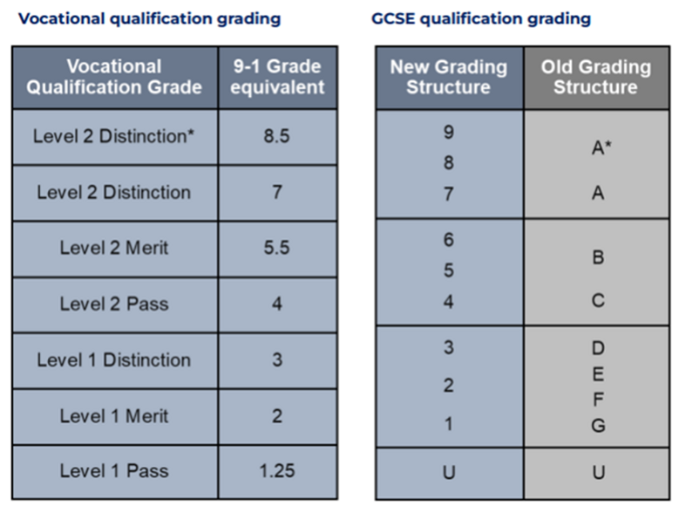
Notes:
All from 2020 (last 5 years)

Slide 11
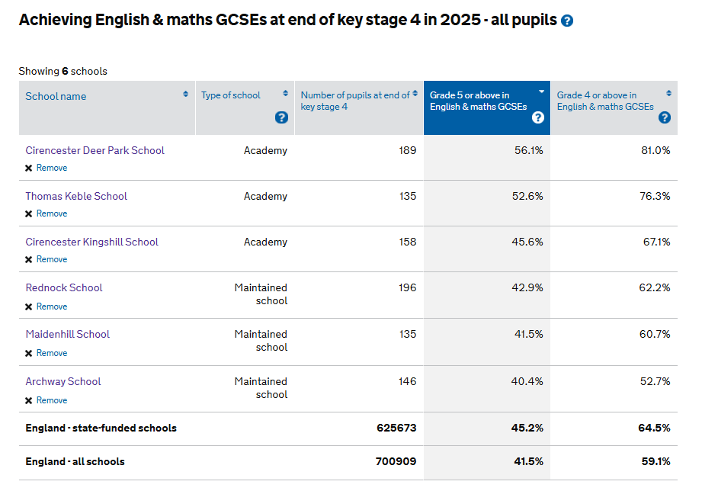
Notes:
Over 10 exam grades, TK students achieve 2 grades higher compared to theripeers nationally

Slide 12
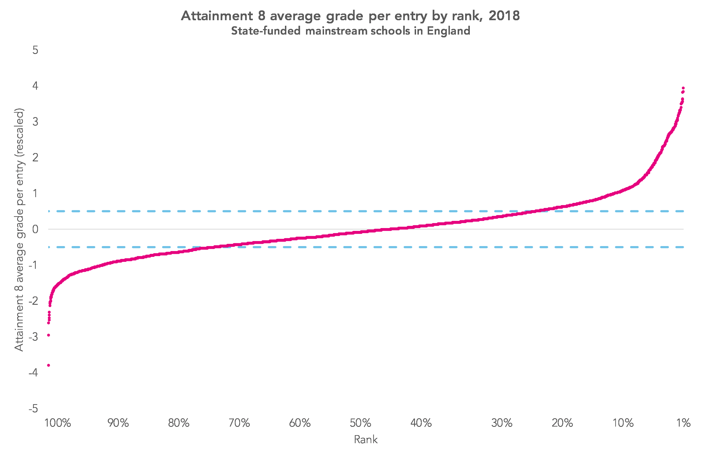
Notes:
Over 10 exam grades, TK students achieve 2 grades higher compared to theripeers nationally

Slide 13
Y10 Reports on progress and meetings in school
Parents
Evening
18/06
September
October
November
December
January
February
March
April
May
June
July
8
7
6
5
6
7
Report 1
GRIT awards 1
21/11
Tests
20/04 to 24/04
Report 2
GRIT awards 2
16/06
Information
Evening
23/10
Notes:
29 weeks of Year 11 pre-exams
145 school days

Slide 14
Reports

Slide 15
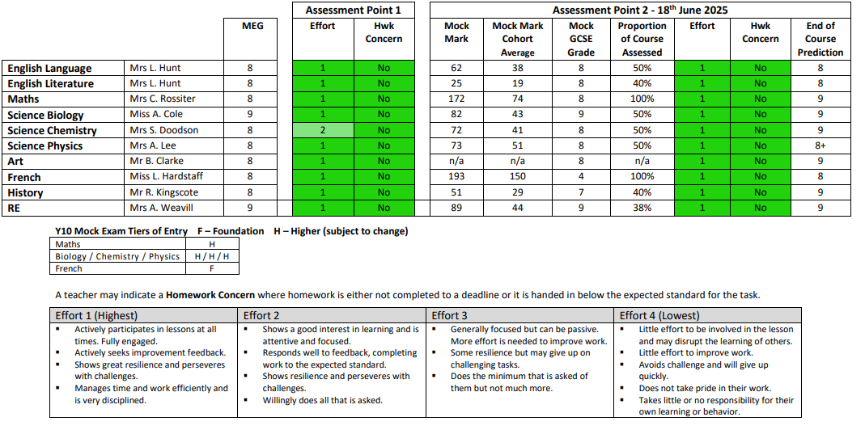

Slide 16

The range of results achieved by similar pupils who took GCSEs in the same subjects in the past.
  Similar Pupils means the same prior attainment, gender and month of birth.
  Range of results means the percentage of each grade achieved
Gives the chance of each grade.
We use ‘the most likely’ as a benchmark or line in the sand.

Slide 19
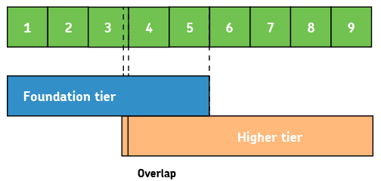
Entered for one tier only

Slide 22
Attendance

Slide 23
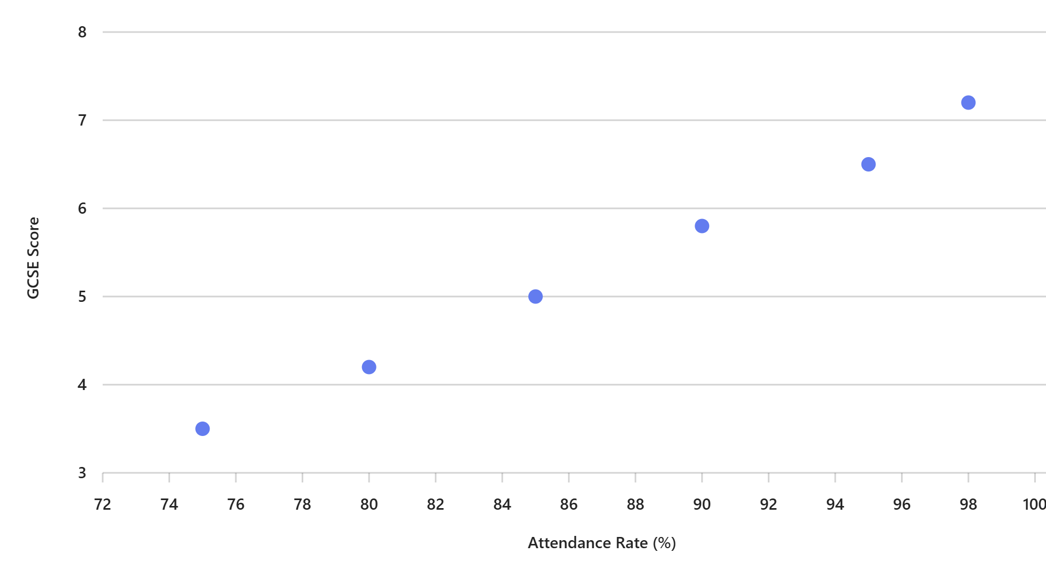
Attending nearly every day in Year 11:
2 x as likely to achieve Grade 5 in English and Maths, compared to 90% to 95% attendance.
3 x as likely to achieve Grade 5 in English and Maths, compared to 85% to 90% attendance.
The link between attendance and attainment in an assessment year
March 2025, Department for Education
Notes:
Department for Education research shows that 17 school days of absence results in all of a student’s GCSE grades dropping by one grade.

Slide 24
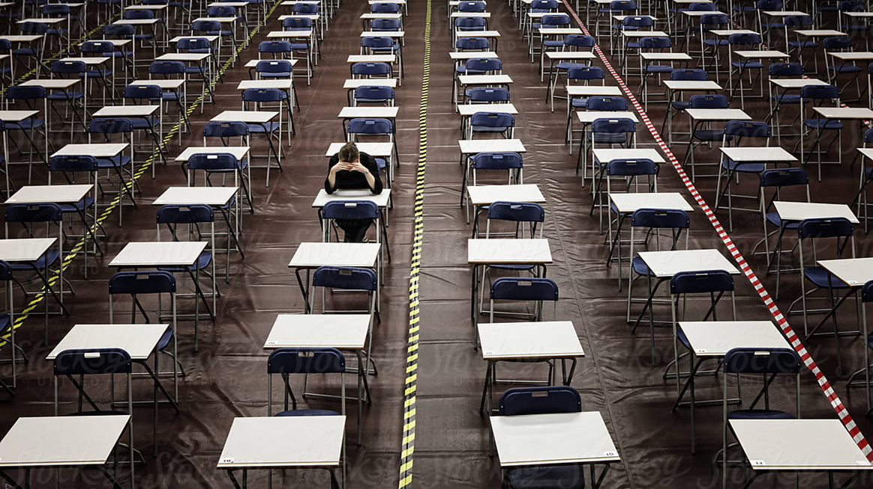
20th April:
Exam fortnight starts

Slide 25
Year 10
Year 11
Invitational
Parents
Evening
November
Parents
Evening
June
Parents
Evening
January
Tiers
in Maths
+ Science
Tests
April
Mocks
December
Report 1
GRIT awards 1
November
Report 2
GRIT awards 2
June
Report 3
GRIT awards 3
October
Report 4
GRIT awards 4
January
Mock marks home
January

Slide 26
Events and activities
Post-results services:
We can check grade boundaries
We can request exam scripts
Service A: ‘Clerical re-check’
Service B: ‘Review of marking’
Prom
July
Results Day
August
June
July
August
September
October
November
Celebration Evening
June
Sports
Awards
July
Certificate Collection
Nov

Slide 27
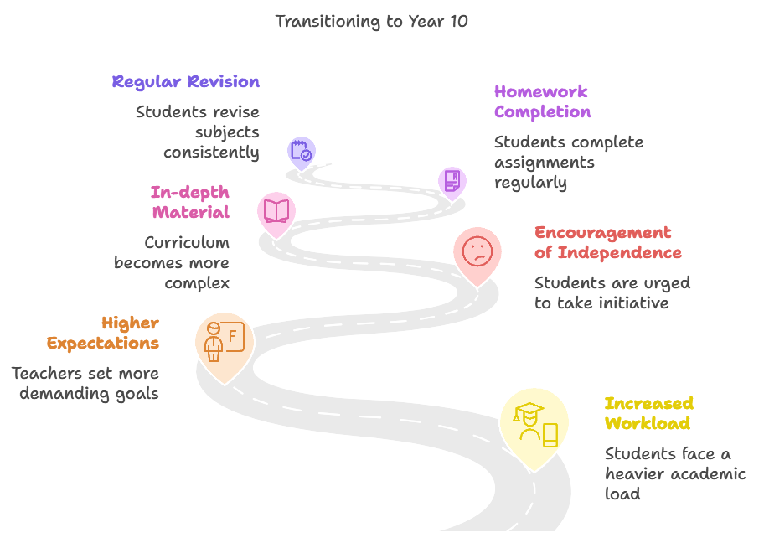

Slide 28







Life After TK
University of Oxford Taster – Thurs 12th Feb
Post-16 Evening – Tues 12th May
Work Experience – w/c 8th June
Choice of college taster days in July
Assemblies in Year 11
1:1 appointments with our careers adviser
Life After TK Event – September 2026

Slide 29

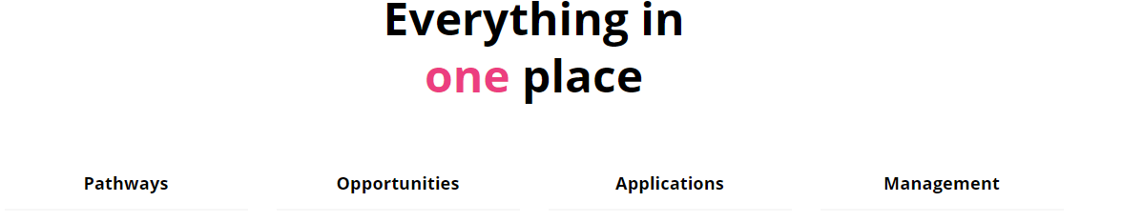

Slide 30
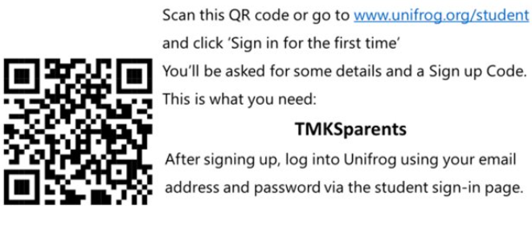

Signing up to Unifrog
Quizzes to help with post-16 choices
Application and CV writing
Parent guides to qualifications
Apprenticeship
Weekly summary emails

Slide 31
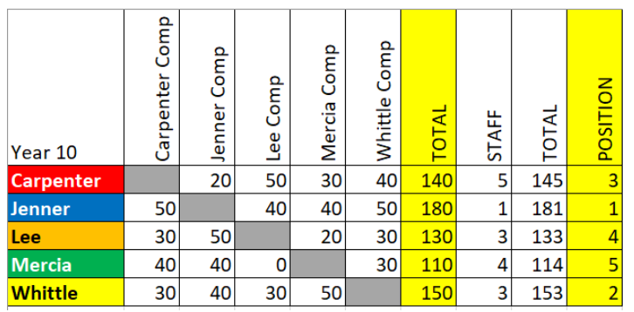





HOUSE COMPETITIONS

Slide 32




Slide 33





Slide 34

PASTORAL SUPPORT
Carpenter (10CSJC)
Mr S Cook – scook@thomaskeble.gloucs.sch.uk
Jenner (10JAC)
Miss A Cole – acole@thomaskeble.gloucs.sch.uk
Lee (10LGP)
Mr G Price – glprice@thomaskeble.gloucs.sch.uk
Mercia (10MMB)
Miss M Beggan – mbeggan@thomaskeble.gloucs.sch.uk
Whittle (10WJLH)
Mrs J Haynes – jhaynes@thomaskeble.gloucs.sch.uk

Slide 35

Mock exams
Mock results day
Leavers' Assembly
Shirt Signing on Leavers' Day
Yearbooks & Leavers' Hoodies
GCSE exams
Prom
GCSE Results Day

