Slide 1
How can you help? Does your child want you to…
Leave them to it, warning them about living in a cardboard box if they don’t revise?
Confiscate their phone to stop them contacting their friends on Instagram?
Be around– not in the room, but pottering about nearby to provide a kind of non-intrusive monitoring?
Show an interest when you return from work and offer to test you or simply make them cups of tea?
Empathise rather than go on the attack? Even small remarks can aggravate fear, such as saying, “Have you looked at your timetable?” or, “Do you know what you need to revise?”
Offer to help drafting a revision timetable?
Take charge of ‘back room operations’, making sure they have a well-ordered, quiet workspace with all the Post-it notes and fluorescent pens they need?
Discuss removing their games console from their bedroom until exams are over?
Ask them what they want from you?
Ask “If I think you are not doing enough work, am I allowed to say anything and what’s a good time to say it?”
Check they know how to revise?

Slide 2

WELCOME to
The 2025 Parents’ Revision Evening
Notes:
Reasons for changing: The format – revision and learning are complex processes and we didn’t feel we could do them justice in an hour’s lecture. The next 5 months will affect the whole family (not just the students) so crucial that you are together hearing the same message sand so can work together. Previously before mocks – too far from the real thing; previously last minute – will contradict much of what we’ll tell you. Today. This gives enough lead in and should also complement responses to the mocks…

Slide 3
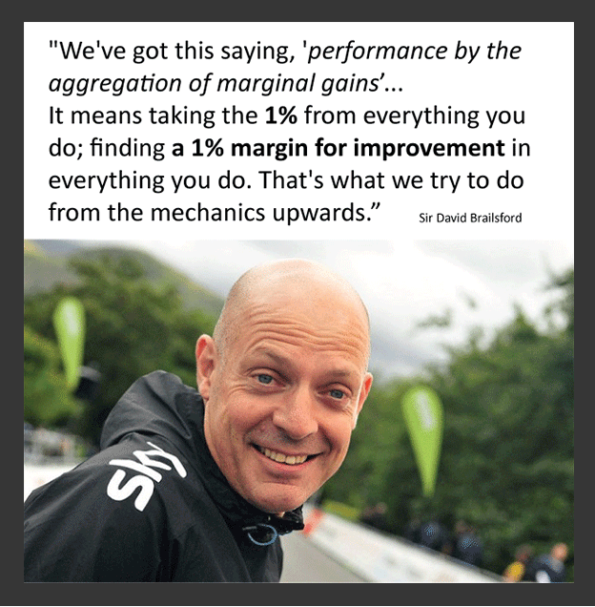

Slide 4
Day | Date | Subject
M | 19/2 | History: The Norman Conquest
T | 20/2 | Maths
W | 21/2 | GCSE PE
M | 26/2 | English Literature Paper 1 (A Christmas Carol and Macbeth)
T | 27/2 | Food, Textiles, RM
W | 28/2 | Science: Session 1 – Triple Biology, Trilogy Higher Chemistry, Trilogy Foundation Physics
M | 4/3 | OCR Sport | Geography: Deconstructing 9 mark questions (targeting grade 5)
T | 5/3 | Maths
W | 6/3 | GCSE PE
M | 11/3 | English Language Paper 1 (fiction)
T | 12/3 | Food, Textiles, RM
W | 13/3 | Science: Session 2 – Triple Chemistry, Trilogy Higher Physics, Trilogy Foundation Biology
M | 18/3 | OCR Sport | History: The People’s Health
T | 19/3 | Maths
W | 20/3 | GCSE PE
M | 8/4 | OCR Sport | History: Goodrich
T | 9/4 | Maths
W | 10/4 | GCSE PE
F | 12/4 | Geography: Deconstructing 9 mark questions (targeting grade 7+)
M | 15/4 | English Literature Paper 2 (An Inspector Calls and Poetry)
T | 16/4 | Food, Textiles, RM
W | 17/4 | Science: Session 3 –Triple Physics, Trilogy Higher Biology, Trilogy Foundation Chemistry
M | 22/4 | English Language Paper 2 (non-fiction)
T | 23/4 | Maths
W | 24/4 | Geography: Data manipulation, graphs and statistics
M | 29/4 | History: The Making of America
T | 30/4 | Food, Textiles, RM
W | 1/5 | Maths

Slide 5
A starting point for revision:
Each subject has produced a revision overview which is on the school website:
Curriculum – Academic - KS4 subjects – Year 11 Revision Information
Exam board
Assessment summary
Past Papers and Mark Schemes
Useful Revision Websites
Revision apps
Recommended revision guides
Other useful information

Slide 6
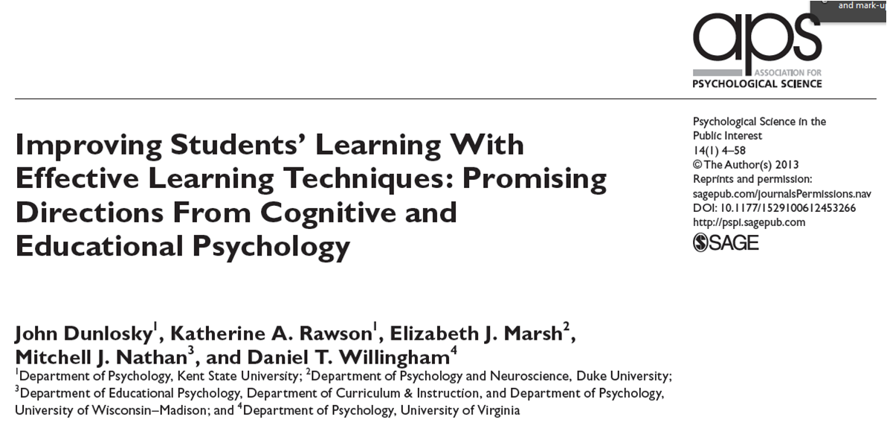
The Revision Process
Notes:
Last 5/6 years has seen an enormous growth of interest and activity in the science of learning – seems bizarre that there wasn’t more before. People have tended to revise and prepare for exams in the same ways for years. Still a lot of good sense in some of those methods but there are others that research has proved to be ineffective and others that may initially seem counter-intuitive but improve knowledge retention….

Slide 7
Not very effective

Slide 8

Re-reading

Slide 9
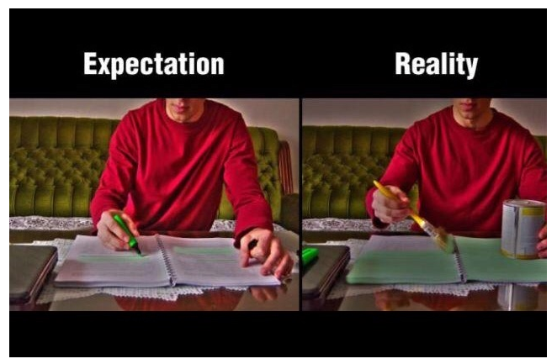
Highlighting

Slide 10

Why?
Low challenge.
Little thinking required.
No quality assurance i.e. how do you know it’s working?
Makes the student think that they are ‘doing something’

Slide 11
And yet...
  59% of Year 11 students thought re-reading notes and text-books was effective;
  31% of Year 11 students thought highlighting notes was effective.

Slide 12

Timescales
First exam is on 8th May
Last exam is on 18th June (25th for contingency)
20 out of 44 exams before May half term – implications for revision?
Study leave begins after Friday May 2nd.
Lessons and in-school revision optional thereafter.

Slide 13
138 hours
20 hours Feb half term (20)
1 hour each night Monday-Thursday (32)
2 hours each weekend (16)
50 hours Easter holiday (50)
20 hours May half term (20)

Slide 14
138 hours
20 hours Feb half term (20)
1 hour each night Monday-Thursday (32)
2 hours each weekend (16)
50 hours Easter holiday (50)
20 hours May half term (20)
138 hours divided by 9 subjects
= 15 hours per subject
to revise 2 years’ work!

Slide 15
So...
How do you make the most of that time?

Slide 16
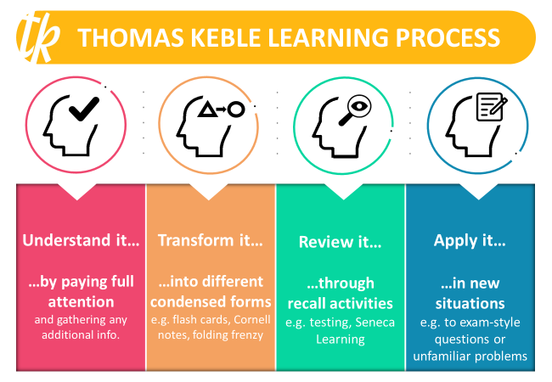

Slide 17


What is our biggest
FEAR about doing an ‘assessment/test’?

Slide 18
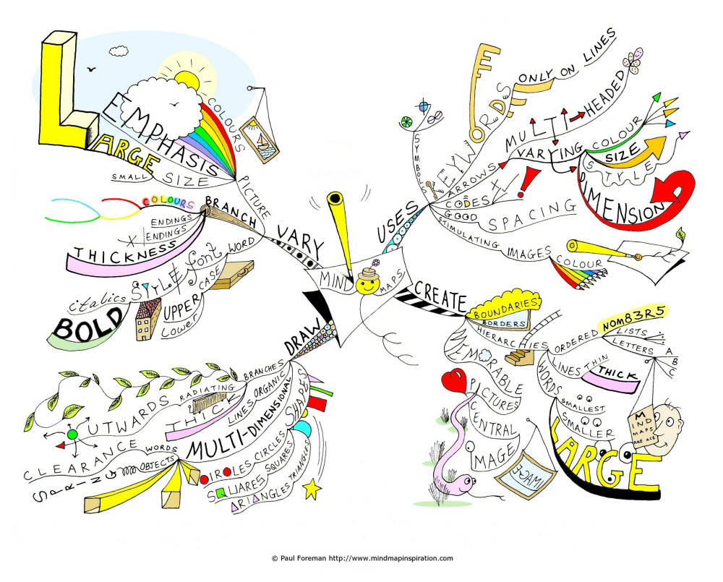
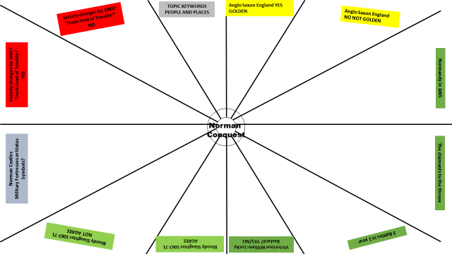
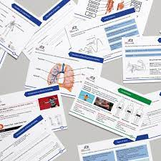
How do we know if we ‘know it’ if we don’t ‘test it’?
SIMPLE ANSWER……..WE CAN’T
The degree of success in TRANSFORMING learning can only be gauged if we TEST to see HOW MUCH WE REALLY KNOW

Slide 19

Students forget 90% of what they learn in class within 30 days
(however much they enjoyed the lesson
/the subject matter was taught well)

Slide 20
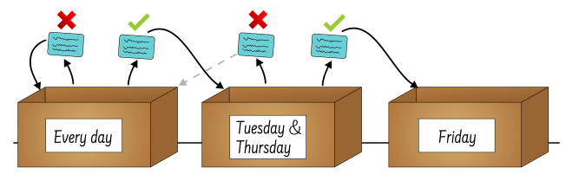
The Leitner Method

Slide 21
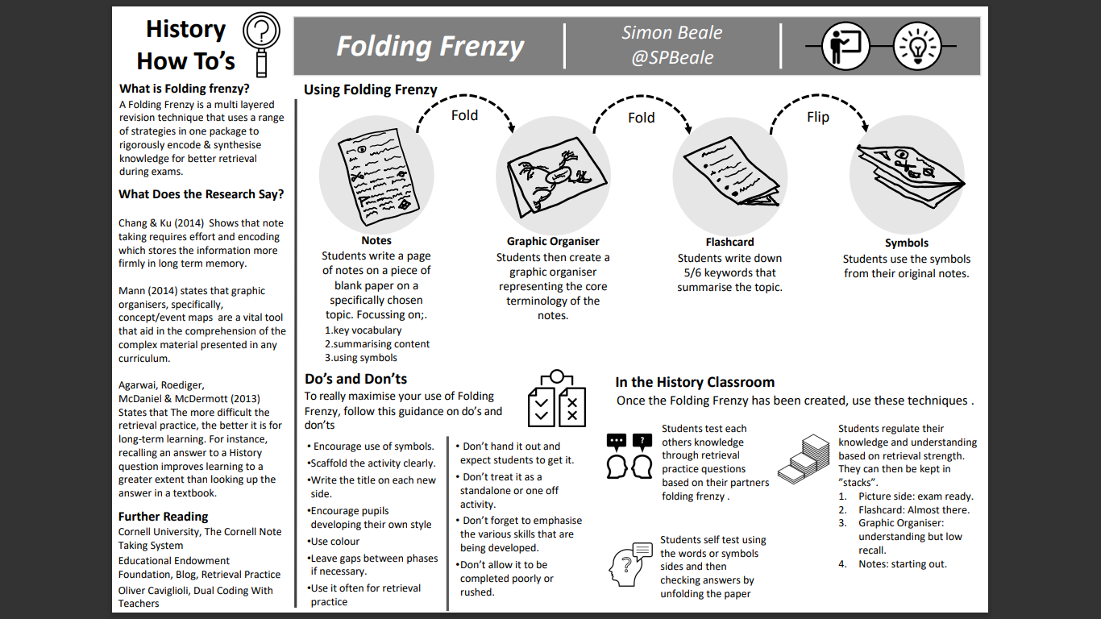


Slide 22
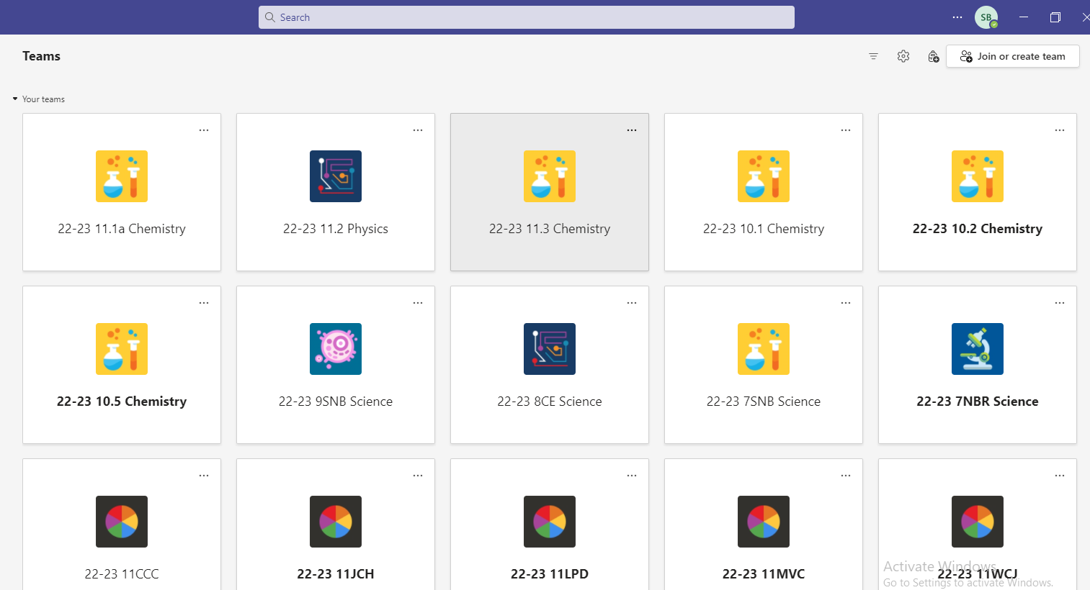



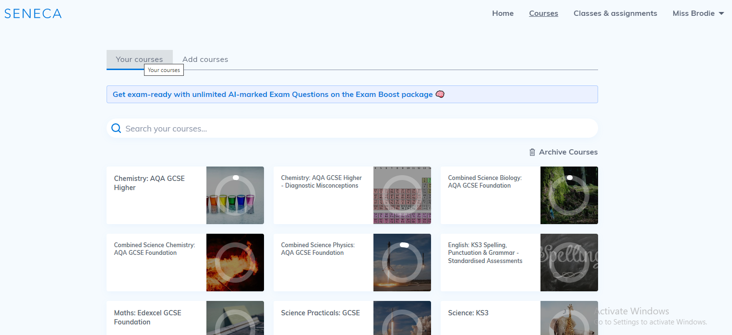




Dr Frost Maths
TEAMs
Seneca

Slide 24
Self-testing and diagnosis of errors
Understanding of the subject
Exam technique
Did you get it wrong because you didn’t know that part of the subject?
Solution: focused revision
Use Folding Frenzy/flashcard envelopes
/Seneca/Quizlet
Did you get it wrong because you didn’t read the question properly or lack of experience with the EXAM PAPER?
Or because you didn’t do exactly what the MARKSCHEME wanted?
Or you haven't seen enough MODEL ANSWERS?
Solution: repeated deliberate practice using the 3 aids above

Slide 25
What is your biggest
FEAR about
THE EXAM PAPER…….?

Slide 26
Anticipation of starting – have the topics I want, come up?
Getting going … turning the page, the first question.....
Being aware of other people in the hall – how fast they are writing, their body language..
Time Management
Stronger/weaker question types
Understanding the COMMAND word in the question
Thinking about what happened LAST TIME I did this paper

Slide 27

Knowing your stronger/weaker question types and confronting them by practising where you are weaker.......
Doing back-to-back questions, different combinations
Working out the timing for each section/question and practising TO THAT TIME

Slide 28
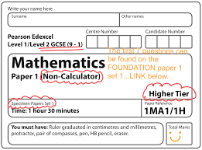
KNOWING and USING the markscheme

Slide 29


Using Model Answers to help
Question 6a
In Interpretation A
the historian Robert
Bartlett argues that
the ‘Harrying of the
North’ had a powerful
impact on northern
England. Identify and
explain one way in
which he does this.
[3]
Let’s look at an example.
Remember: You will be awarded 1 mark for the identification of a relevant and appropriate way in which the historian argues that the ‘Harrying of the North’ had a powerful impact, 1 mark for a basic explanation of this and 1 mark for developing your explanation.
Before you click on the example answer, have a go at answering the question yourself.
In 1069, William marched on York and crushed the rebellion. The Normans devastated the North of England. They sacked every village and farmstead as they went. Then William divided his troops into smaller bands who destroyed any crops and livestock they could find ...
A huge area across northern and central England was laid waste by this ‘scorched earth’ on the northern rebels. Plotting the settlements destroyed by the Normans shows the scar that was carved across the country by William’s army. Sixteen years later, these areas were still desolate wasteland.
Interpretation A – An extract from the script of The Normans, a BBC television series, 2010.
Example answer
The historian argues that the Norman conquest had a powerful impact because it had a long term effect; the impact was felt for a long time. [1] This is shown by the description of the areas 16 years later which are described as still a ‘desolate wasteland’. [1] This image is supported by the use of the word ‘scar’ which suggests that the impact is long lasting and can still be seen. [1]
Click here for an example of Question 6a
EXAMPLE ANSWER
CLOSE

Slide 30
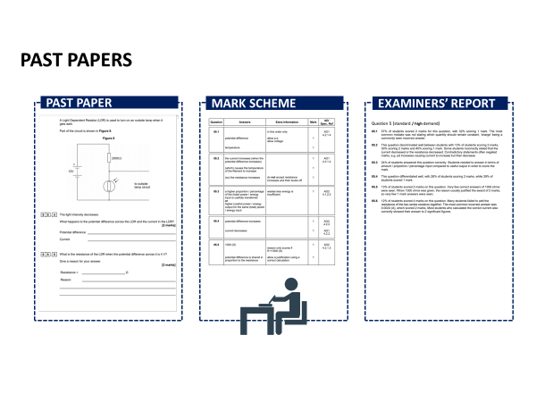

Slide 31

TESTING = BEING BRAVE
1% MARGINAL GAINS;
-each week,
-on each practice question,
-in each subject…….

Slide 32

Revision Planning
Making the revision timetable

Slide 33
Revision Planning
Making the revision timetable
Only 49% of Year 11 students made
a revision timetable for their mock exams!

Slide 34
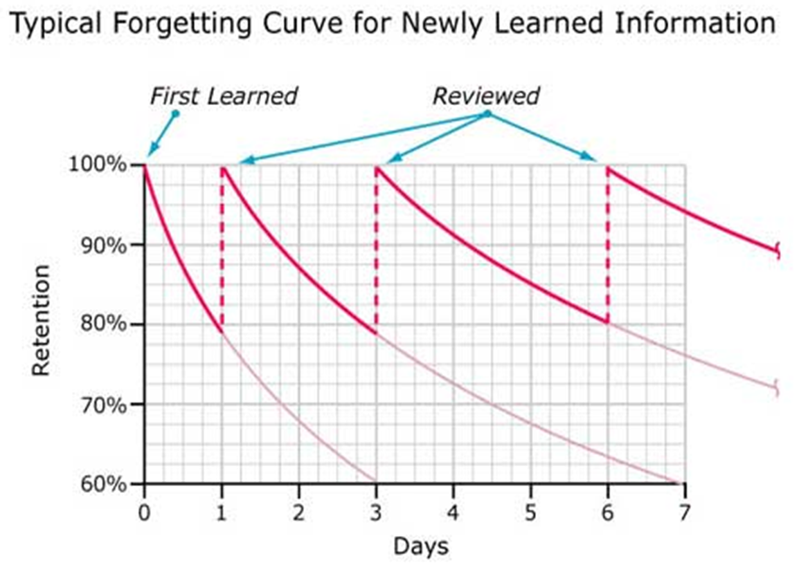
Principle 1: SPACED RETRIEVAL PRACTICE
When we learn something, we forget it
When we revisit something we’ve learned repeatedly, we remember it better
This is shown in the Ebbinghaus Forgetting Curve

Slide 35
Principle 1: SPACED RETRIEVAL PRACTICE
Only 47% of Y11s used this for the mocks!
When we learn something, we forget it
When we revisit something we’ve learned repeatedly, we remember it better
This is shown in the Ebbinghaus Forgetting Curve

Slide 36
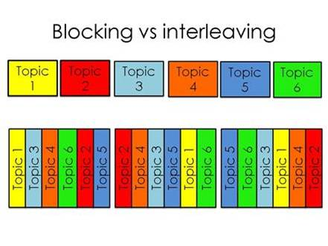
Principle 2: Interleaving vs blocking
“Blocking” your revision – focusing on one topic for a long time then moving on to the next topic – is inefficient.
“Interleaving” your revision is far more effective as reducing the accessibility of information in memory fosters additional learning of that information.

Slide 37
Principle 3: Interleaving and chunking
For interleaving to work, you have to break down your revision into “chunks”
It’s no good putting “Biology” into your revision calendar – you need to be specific
GCSE Biology includes:
  Health
  Responses to the environment
  Evolution
  Ecology
  Cells
  Photosynthesis
  Organisms and their environments
  Protein functions and uses
  Respiration
  Genetics
  Speciation

Slide 38
Easter Revision
I suggest that for at least 5 days a week over the Easter holiday, students work a school day:
Session 1 – 9:00-9:50
Session 2 – 10:15-11:05
Session 3 – 11:30 – 12:20
Session 4 – 1:15 – 2:05
Session 5 – 2:30 – 3:20
They could even follow their school timetable.

Slide 39
Revision timetable
Date/Session | Revision | Activity
Mon 14th April 1 | Geog: Coasts | Review –Quizlet flashcards
2 | RE: Christian marriage | Transform – Revision clock
3 | Maths: quadratic equations | Test – Practice Paper Q2,4,6
4 | Eng Lit: Macbeth | Transform – Lady Macbeth folding frenzy
5 | Science: Forces | Review – Seneca website

Slide 40

The importance of study breaks:
Study time periods should be broken down into 20-25 minute sections with small rests in between.
We tend to remember first things and last things rather than the things in between. So, the more well-spaced and short breaks we have, the more beginnings and endings we have, and the better our brain will be able to remember.
Brief breaks are also essential for relaxation: they relieve the muscular and mental tension that inevitably builds up during periods of intense concentration.

Slide 41
Revision planner apps:
Adapt - free Revision Timetable App for A-level & GCSE (getadapt.co.uk)
My Study Life

Slide 42

Time spent planning is likely to reduce stress – parents can be very helpful here!

Slide 43
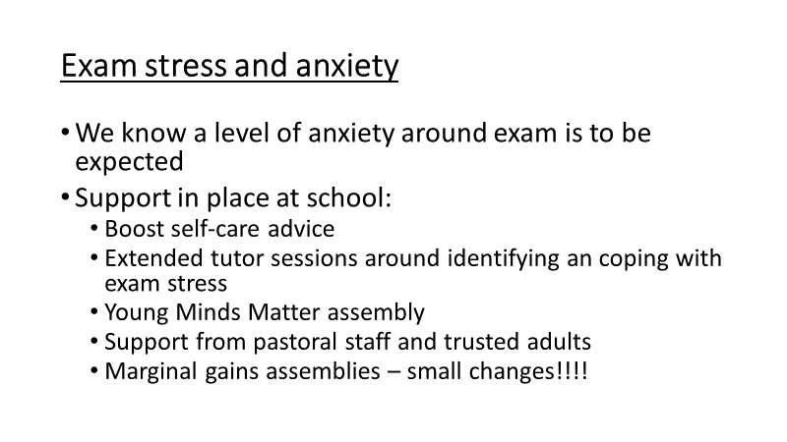

Slide 44
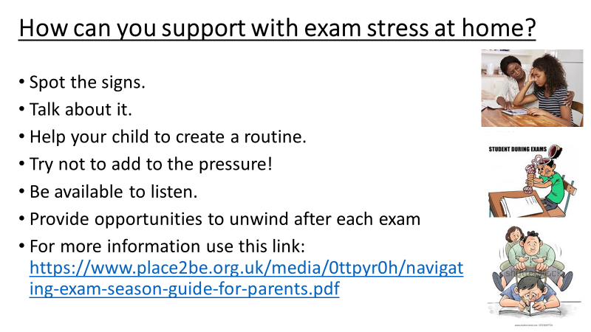

Slide 45


Slide 46
Exam Day
Be prepared.
2. Try a breathing exercise if you're feeling overwhelmed. Breathe in through your nose for 4 counts, hold it for 2 counts, and breathe out for 7 counts. Repeating this can help you feel calm.
3. Take a few minutes to read the instructions and questions.
4. Plan how much time you'll need for each question.
5. Once the exam is finished, forget about it.

Slide 47
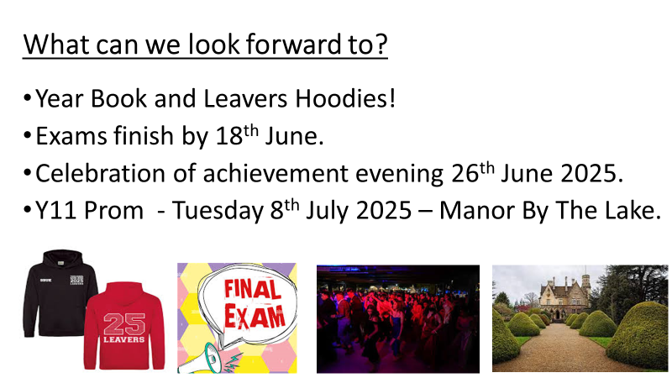

Slide 48


